Slide 1
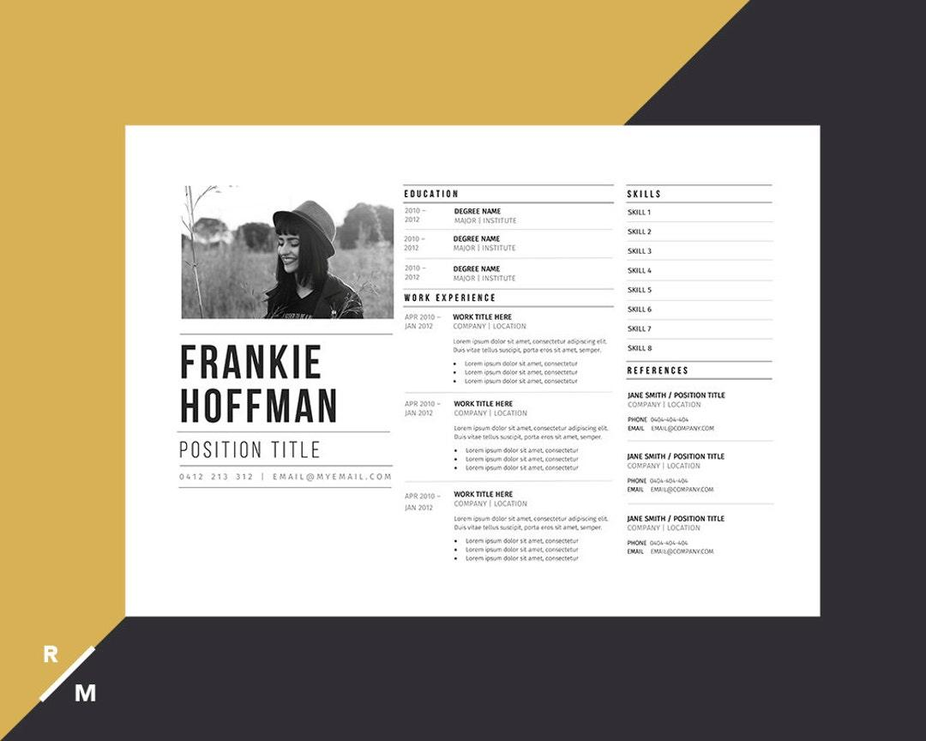
CSE299 Project
Group 7
Resumate
Update
First Week Progress Report

Slide 2
Introduction to Resumate: AI Resume Builder with Rating System
Resumate is designed to help users build professional resumes enhanced by an AI rating system. This tool aims to optimize resume quality through automated feedback. Our focus this week was establishing the project scope and laying groundwork for the user interface and core functionality.

Slide 3

Use of Figma for Designing Layouts: Home Page, Templates, Features
We utilized Figma to design the layout for the home page, resume templates, and key features. These designs provide a structured visual guide to ensure a cohesive and user-friendly interface. This process helped us clarify design goals before coding began.

Slide 4
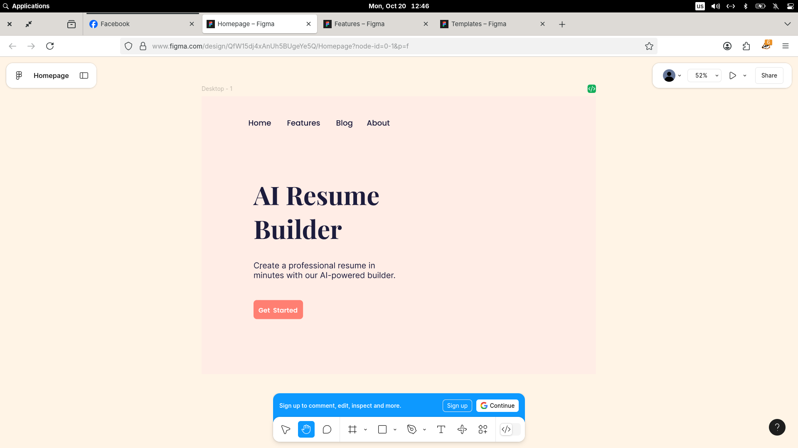

Slide 5
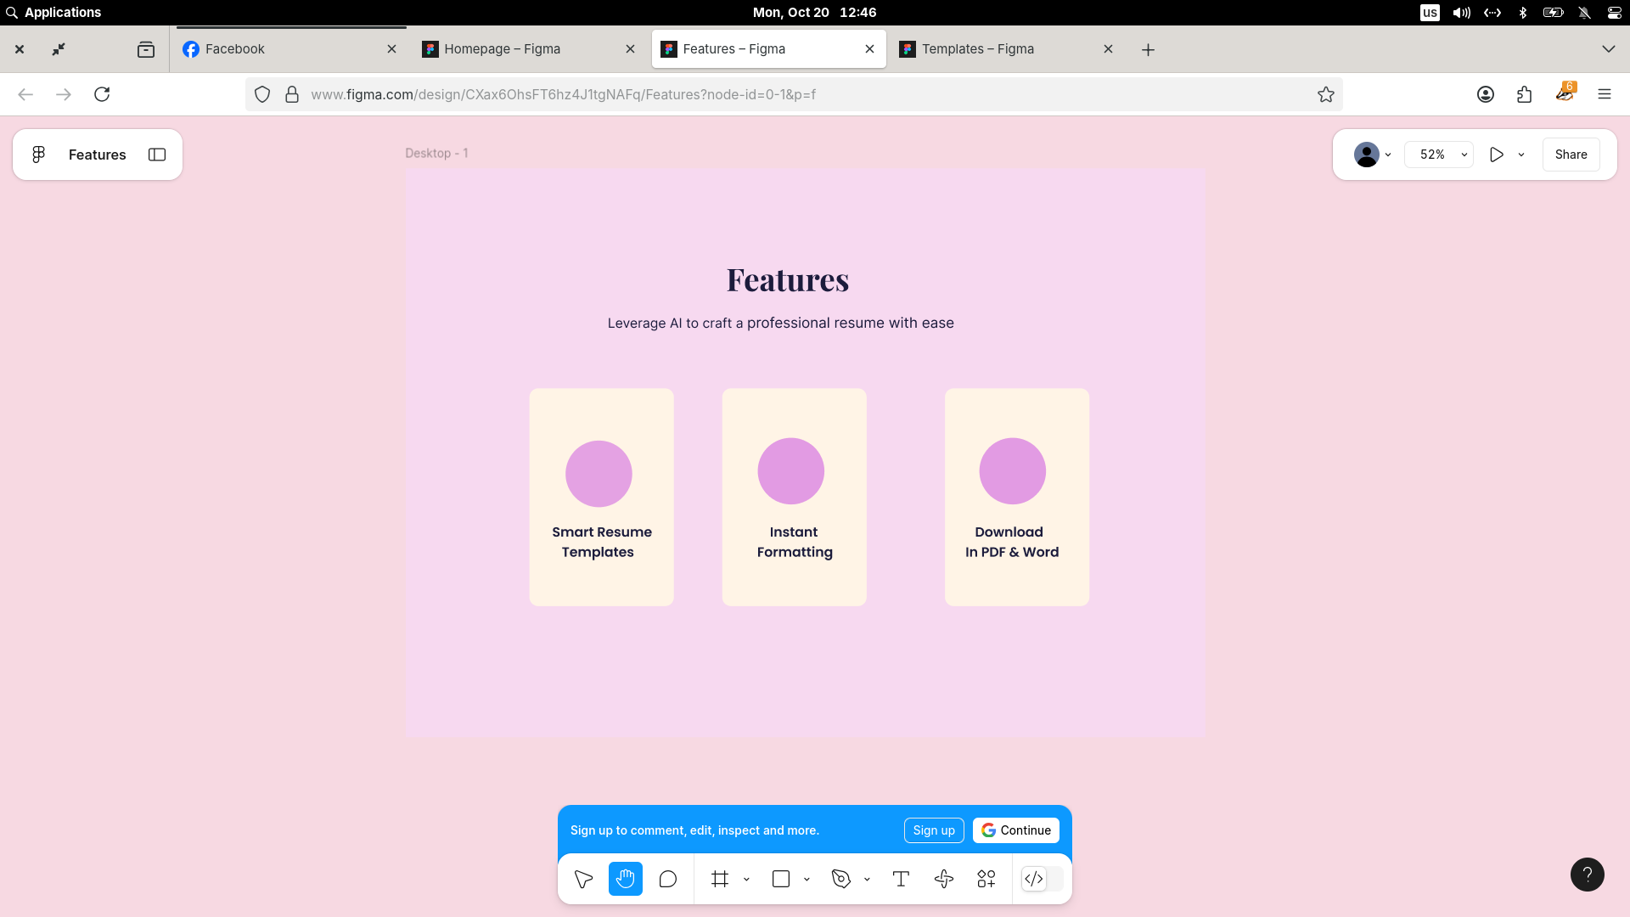

Slide 6
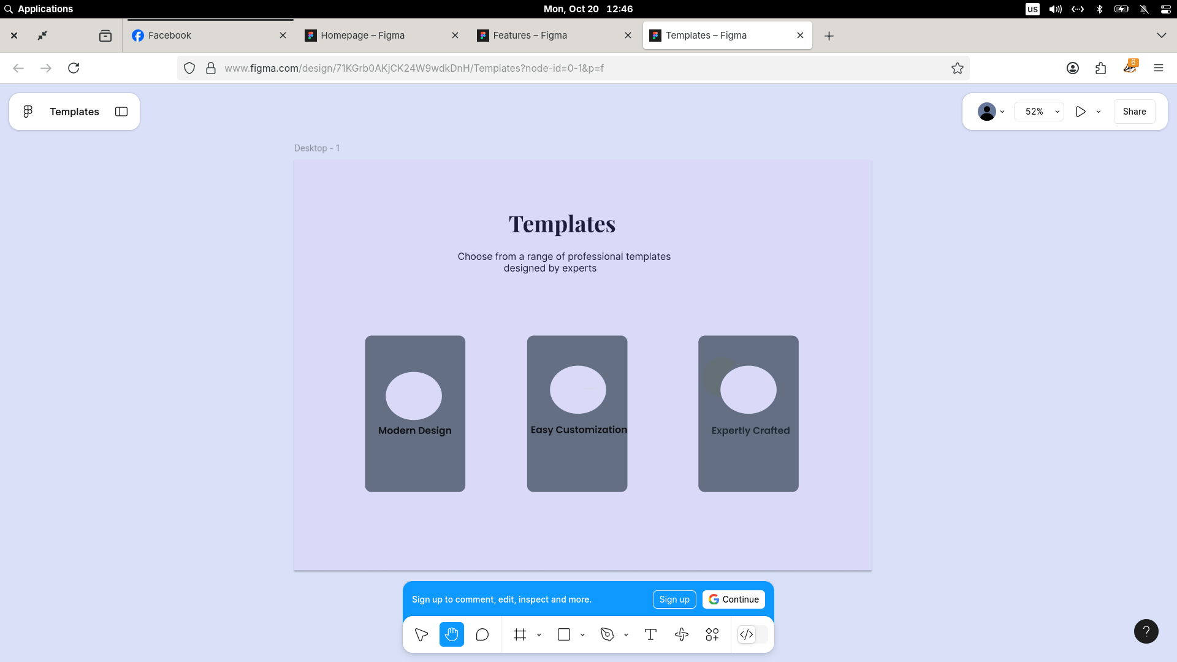

Slide 7
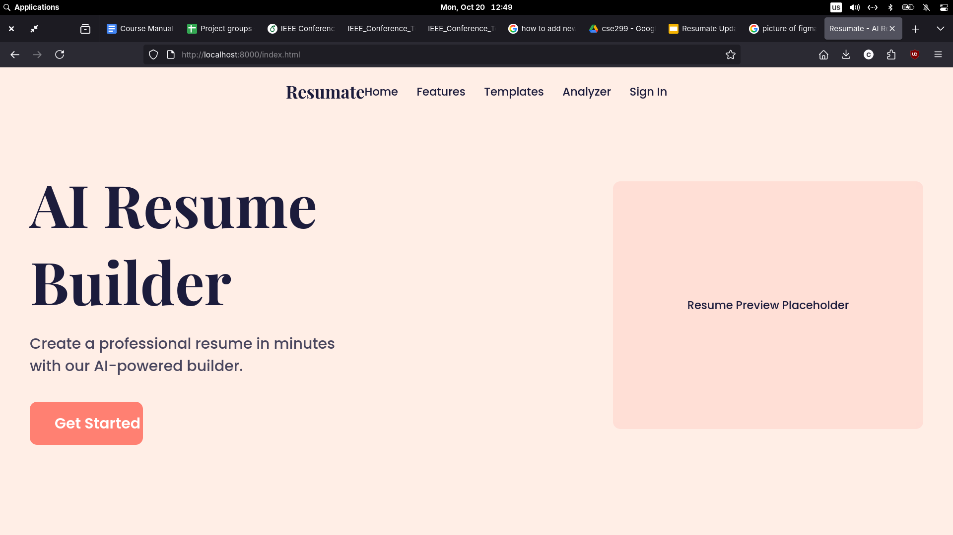
Initial Development Stage: index.html and CSS Work
This week, we initiated the development of the index.html file alongside foundational CSS styling. Our focus was on establishing the website’s basic structure and visual coherence. This early progress sets the stage for integrating functionality and refining the user interface in subsequent phases.

Slide 8
What is next?
The first week of the Resumate project successfully laid a foundation through refined design and initial coding efforts. Utilizing Figma for layout planning and starting HTML/CSS development has positioned the team well for upcoming milestones. Continued collaboration and structured progress will drive the project towards its defined goals.
We plan to work on developing the backend using Laravel, create the remaining pages of the website, and enhance the project with JavaScript to make it more dynamic and responsive. Additionally, we’ll focus on fine-tuning various features to improve overall functionality and user experience.

Slide 9
THANK YOU

